Slide 1
Analysis of IPL (2008-15)
By:-KESANA BHANU MANIKANTA (11904233) Project Presentation under session Aug 2021 - Dec 2021
Guide: Prof. Harneet Kaur Dept. of CSE , LPU

Slide 2
Agenda
Introduction
Scope and Motivation
Details of Dataset
Tools and Technology
Visualization
Agenda
Cricket, especially the IPL has the maximum uncertainty where a single over can completely change the whole momentum and circumstances of the game.
Doing Sports analysis is the process of collecting past matches data and analysing them to extract essential and meaningful insights.
Using descriptive and inferential statistics, this dataset is a gold mine depending on how deep the analysis is done, and on top of that, the data of 2015 is also available.
Visualisation of this dataset is the key part of our project as it covers a lot of factors determining the winner of the match.
As the IPL happens every year and is very popular in India therefore analysis
and finding insights can be very useful for future matches.
1/7

Slide 3
Agenda
Introduction
Scope and Motivation
Details of Dataset
Tools and Technology
Visualization
Introduction
The idea is to analyse the IPL data hosted by Kaggle to come up with something interesting and useful.
The insights from the dataset can really be helpful for the IPL management and team coach to improve themselves.
Handling all the factors like the effect of home ground and toss winner is a real-world problem.
For future progress, the Machine Learning model can be applied to determine the probability of winning a match on the basis of previous data.
1/7

Slide 4
Agenda
Introduction
Scope and Motivation
Details of Dataset
Tools and Technology
Visualization
Scope and Motivation
Predicting the winner of the next season of IPL based on past data can give us idea that which team has higher probability of winning the match which seems pretty interesting.
As the dataset tell about the team, who won the toss along with the information of venue and man of match. The chances of winning the match by that team can also be determined on basis of these factor which is beneficial for sponsors and advertisement also.
As a cricket enthusiast, working on this dataset was fun and getting the insights was interesting.
Predicting the outcome of the match is a challenge but by means of inferential statistics and data visualization we can overcome the challenge to a certain extent.
1/7

Slide 5
Agenda
Introduction
Scope and Motivation
Details of Dataset
Tools and Technology
Visualization
Details of Dataset
The dataset was taken from the kaggle and I have chosen the IPL data from the year 2008-2015.
The dataset has nearly 516 rows and 17 columns with some missing and wrong data (mostly na values).
The dataset has detailed information about which team won the match by how much margin (wicket or runs depending on the team to opt for batting or bowling).
The dataset has columns telling about the man of the match, venue, and the dataset was not sorted based on season, so data was sorted at the beginning.
1/7

Slide 6
Data Cleaning
In the Dataset there were a lot of missing values in many rows and columns and cleaning the dataset is important to get graphs and insights without errors.
The matches where no result (maybe due to bad weather), the player of match and match-winner cannot be determined therefore data in those cells was filled with 'Not Possible’.
1/7

Slide 7
Agenda
Introduction
Scope and Motivation
Details of Dataset
Tools and Technology
Visualization
Tools and Technology
The Tools used for the analysis of the dataset:-
Pivot table: A PivotTable is a powerful tool to calculate, summarize, and analyze data that lets you see comparisons, patterns, and trends in your data. PivotTables work a little bit differently depending on what platform you are using to run Excel.
Slicers: Slicers are visual filters. Using a slicer, you can filter your data (or pivot table, pivot chart) by clicking on the type of data you want. For example, let's say you are looking at sales by customer profession in a pivot report.
Hyper Linking: Hyperlinking function returns a hyperlink from a given destination and link text.
1/7

Slide 8
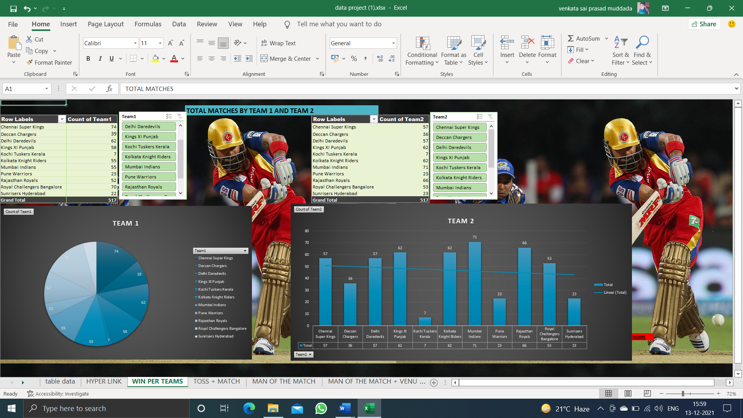
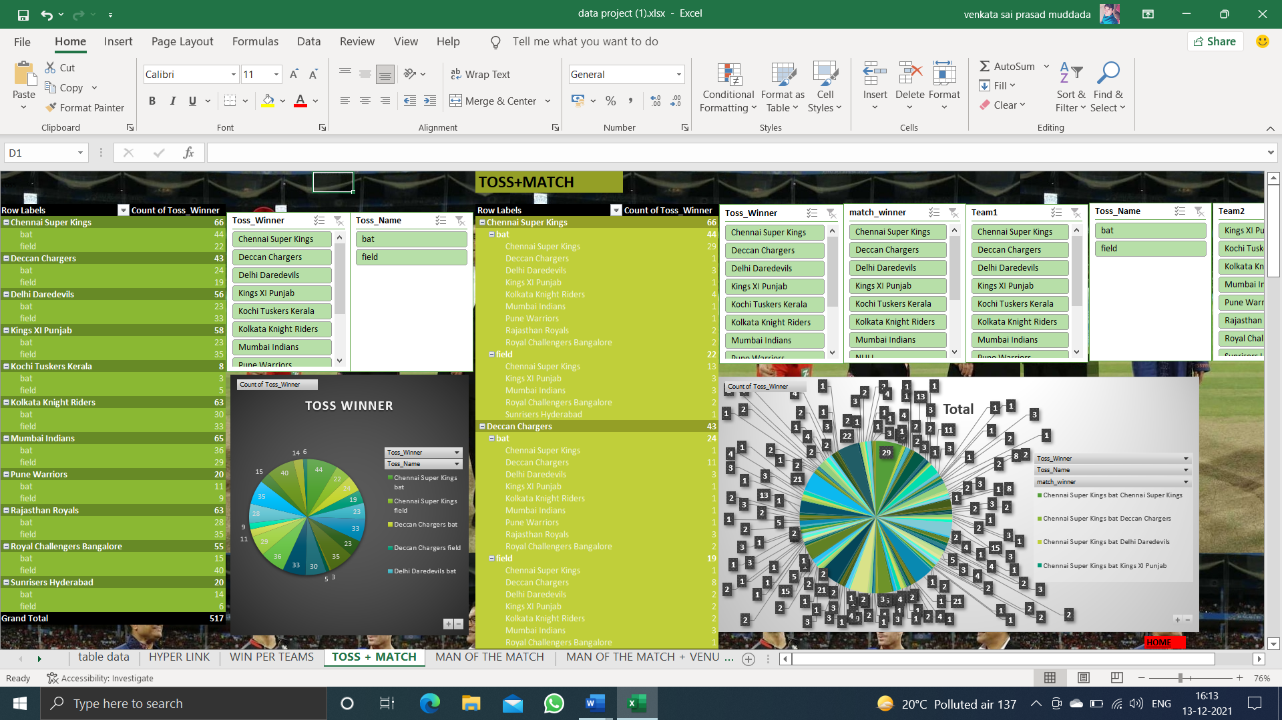
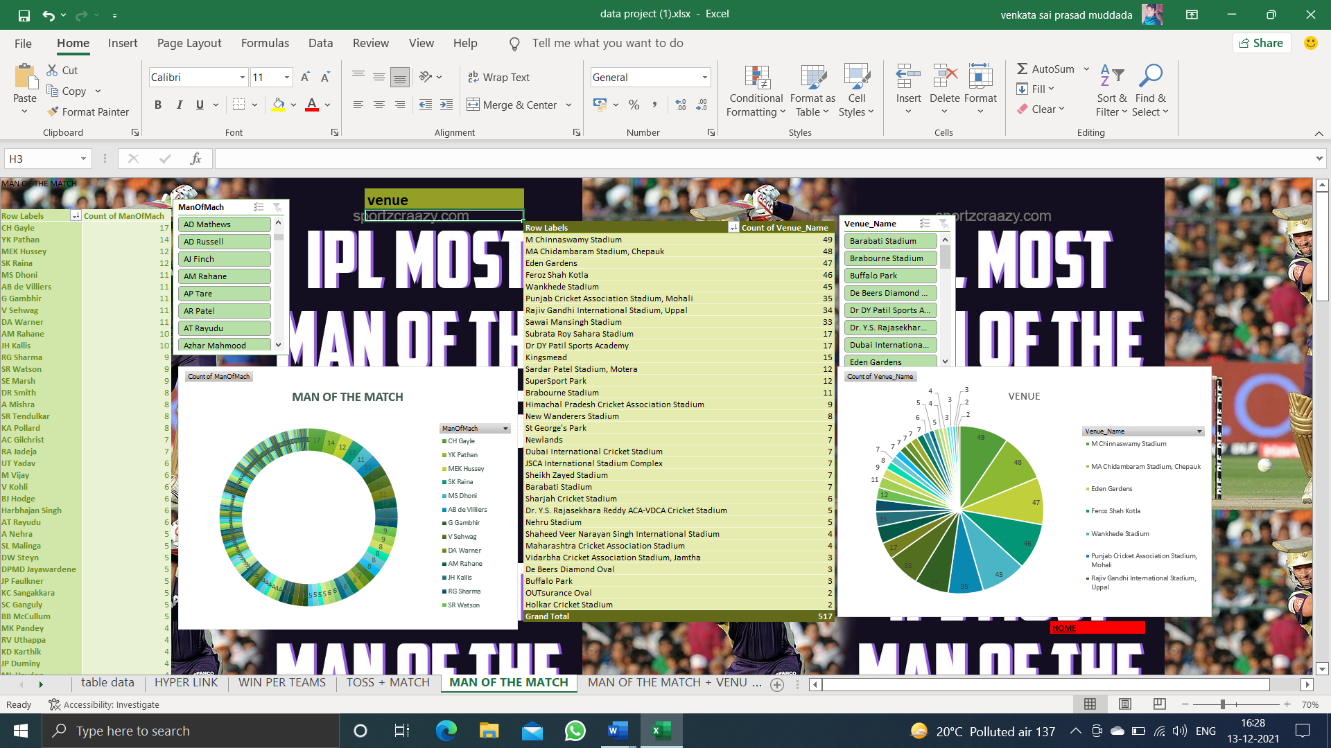
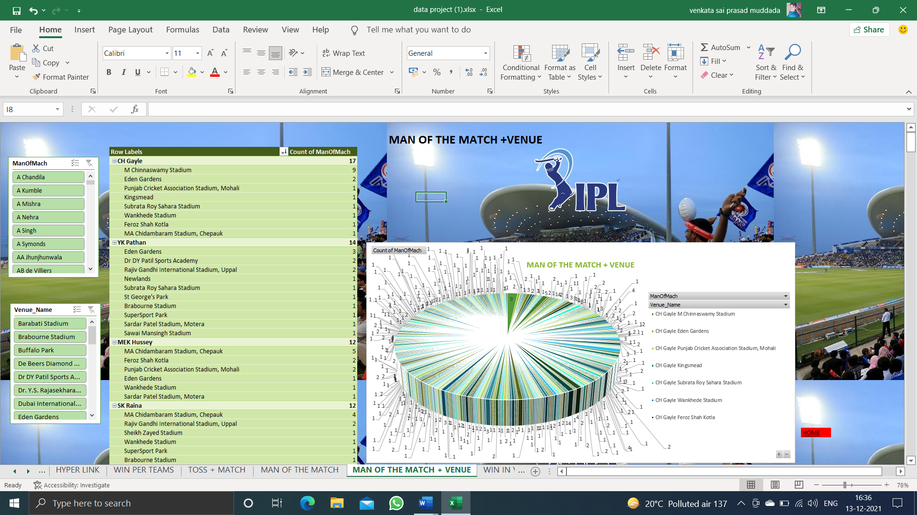
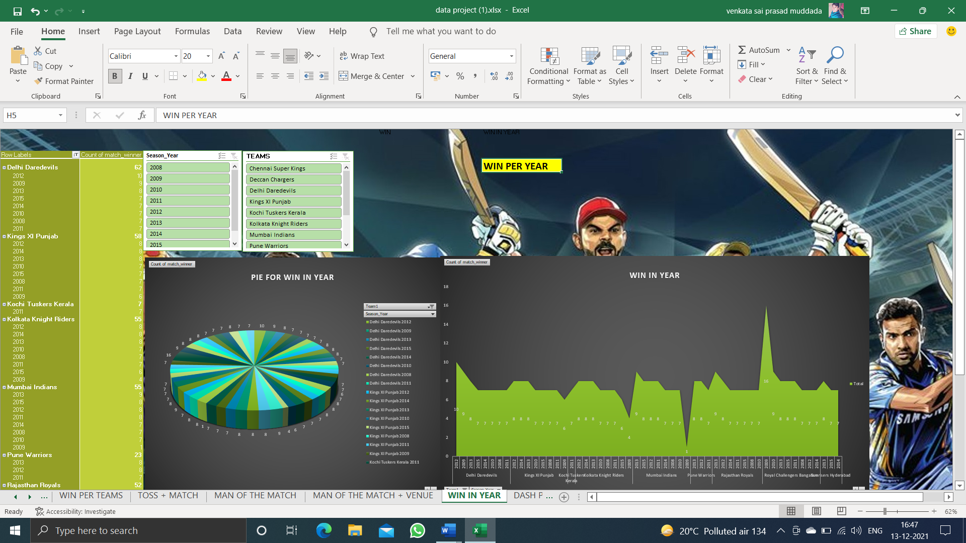
Agenda
Introduction
Scope and Motivation
Details of Dataset
Tools and Technology
Visualization
Visualization
1/7

Slide 9
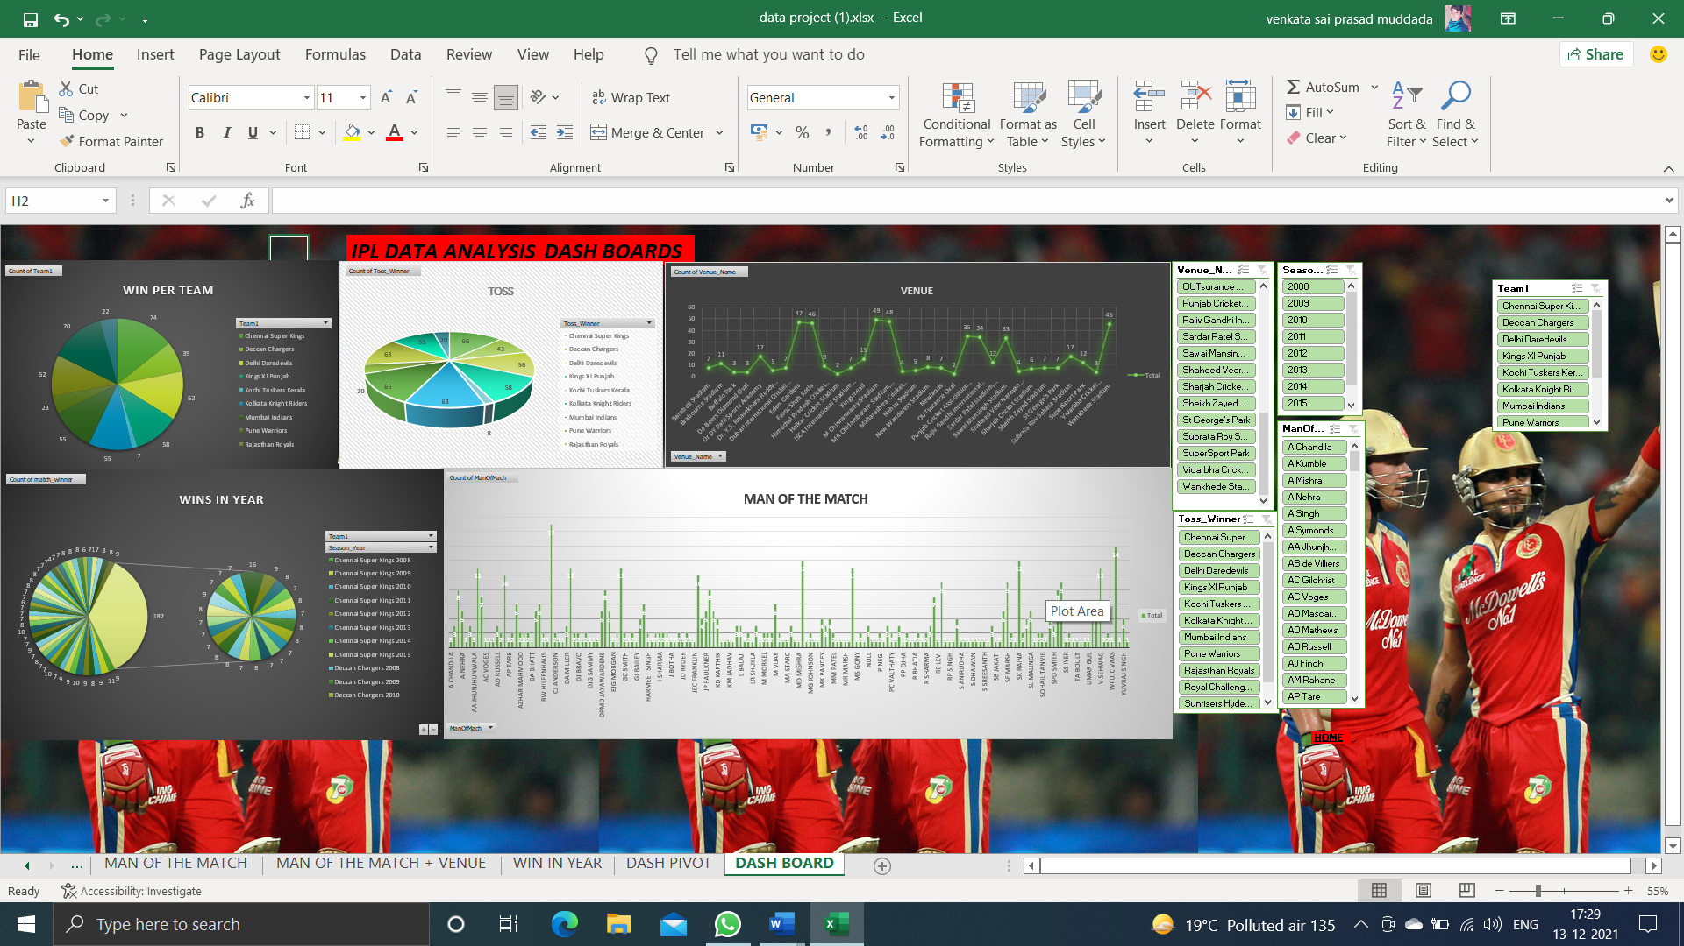
Agenda
Introduction
Scope and Motivation
Details of Dataset
Tools and Technology
Visualization
Visualization
1/7

Slide 10
References
The dataset was taken from kaggle.com
For cross-checking the details in the dataset we referred to www.IPLT20.com
The dataset link is:-https://docs.google.com/spreadsheets/d/1OxxUH46R9_BDlkSOoC4E3vBdbWaNc2zq/edit?usp=sharing&ouid=100235546878305073609&rtpof=true&sd=true

Slide 11
CONCLUSIONS
Totally 13 teams has participated in IPL History and few teams like: Pune Warriors, Kochi Tuskers Kerala, Rising Pune Supergiants, Gujarat Lions and Delhi Capitals has been only in 2 seasons and their success rate of is good when compared to other teams.
Mumbai Indians, Royal Challengers Bangalore and Chennai Super kings are best Defending teams.
Royal Challengers Bangalore, Mumbai Indians and Kolkata Knight Riders are the best Chasing teams.
From the year 2014 most of the teams are opting to field after winning toss and are also successful in winning the match.
Overall Chennai Super Kings and Mumbai Indians have high success rate and these two teams are the most successful teams as CSK has won 4 seasons and MI has won 3 seasons.

Slide 12
CONCLUSIONS
From the analysis, it was concluded that Chennai Super Kings and Mumbai Indians are more likely to win upcoming IPL seasons.
Kolkata, Bangalore and Delhi is more likely to have bad weather during the IPL season.
Teams have won more matches in their home grounds.
M Chinnaswamy stadium and Eden Gardens is best Suited for Feilding and MA Chidambaram Stadium, Chepauk is best suited for Batting.
At Mumbai highest number of matches has been played.
Chris Gayle has most title for man of the matches i.e 21.
Delhi Capitals has more chances of winning the toss followed by Deccan Chargers but Delhi Capitals has played only two seasons.
There is no linear relation between win_by_runs and win_by_wicket as correlation coefficient is negative.

Slide 13
Thank You

